Slide 1


CAPSTONE PROJECT
HR ATTRITION ANALYTICS
Presented By
Student Name: V MEGHANA
College Name: OSMANIA UNIVERSITY
Department: BUSINESS MANAGEMENT
Email ID: autodidact.technocrat1609@gmail.com

Slide 2
OUTLINE:
Problem Statement
Proposed System/Solution
Development Approach
Algorithm & Deployment
Result
Conclusion
Future Scope
References

Slide 3
Problem Statement:
Employee attrition is a critical issue in human resource management as high turnover rates lead to increased recruitment cost, loss of experienced employees, reduced productivity, and negative impact on organizational performance. Modern organizations maintain large volumes of employee data including demographics, job role, salary, department, education, experience, and performance metrics. However, without proper analytical tools, it becomes difficult to identify the key factors influencing employee attrition.

Slide 4
Proposed Solution:
The proposed solution is an HR Attrition Analytics Dashboard built using Power BI. The steps include: • Import HR dataset • Clean and transform data • Create interactive dashboard • Show employee statistics visually • Help HR team take better decisions Features: • Attrition analysis • Department wise employees • Salary analysis • Job role analysis • Gender distribution • Risk Modelling

Slide 5
Approach:
Step 1 – Problem Identification Studied HR Analytics domain and identified employee attrition as a major problem affecting organizational performance and cost. Step 2 – Data Collection Collected HR employee dataset containing information such as age, department, salary, job role, education, experience, and attrition status. Step 3 – Data Understanding Analyzed dataset structure and identified important fields required for attrition analysis. Step 4 – Data Cleaning & Preprocessing Handled missing values Checked data types Removed errors and duplicates Prepared data for analysis using Power BI Power Query.

Slide 6
Step 5 – Data Modeling Created relationships and measures to calculate: • Attrition Rate • Total Employees • Active Employees Step 6 – Data Analysis Performed attrition analysis based on: • Department • Age group • Salary range Step 7 – Dashboard Development Designed interactive HR Analytics Dashboard in Power BI using charts, cards, slicers, and filters. Step 8 – Result Interpretation Observed patterns and trends in attrition to help HR understand reasons for employee turnover

Slide 7
Algorithm & Deployment:
Data Transformation & Analysis: Step 1 – Data Import Imported HR Analytics dataset (CSV) into Power BI. Step 2 – Data Cleaning (Power Query) • Removed null values • Checked column data types • Renamed columns • Removed unwanted columns • Corrected categorical values Step 3 – Data Transformation • Converted salary and age to numeric format • Grouped fields where required • Created calculated columns • Formatted date / number fields Step 4 – Data Modeling • Created relationships between tables (if any) • Defined primary fields for analysis

Slide 8
Algorithm & Deployment:
Step 5: Perform Attrition Analysis Compare attrition by department Compare attrition by age Compare attrition by salary Compare attrition by job role Step 6: Create Dashboard Add charts and KPI cards Add filters and slicers Design interactive layout Step 7: Generate Insights Identify high attrition areas Understand employee trends by preparing Risk Model Support HR decision making Step 8: Deploy Dashboard Save Power BI file Refresh data when needed Use dashboard for analysis

Slide 9
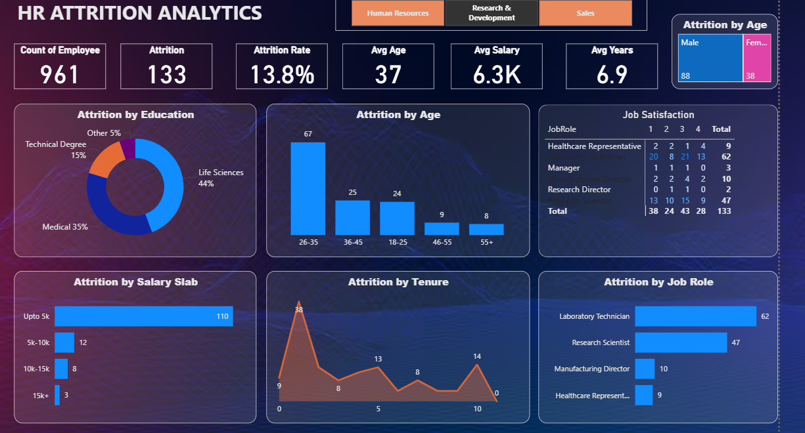
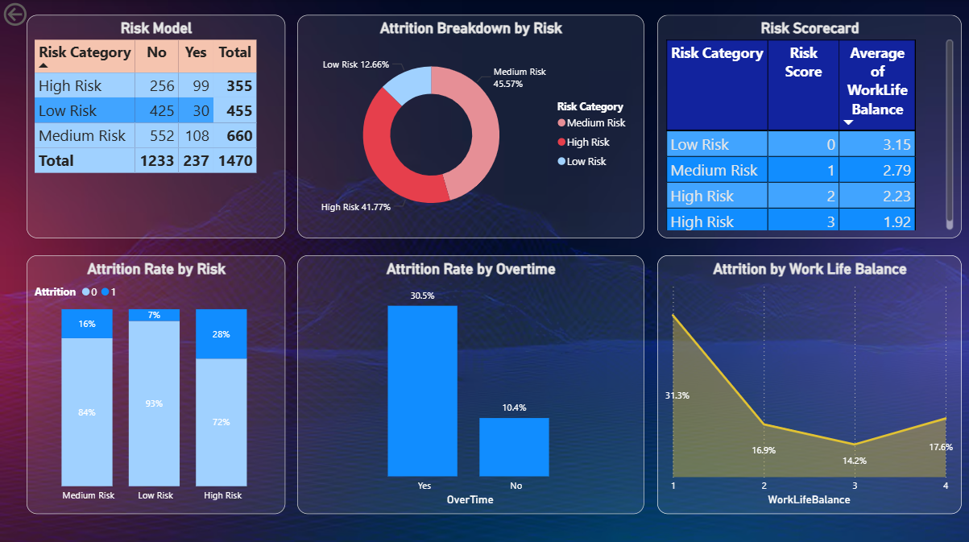
Result:
Result 1: HR Attrition Analytics Dashboard Result 2: Risk Modelling
This dashboard presents key KPI Metrics such as Count of Employees, Attrition, Attrition rate, Avg Salary and Attrition analysis by Education ,Age, Gender, Job satisfaction, Salary, Tenure and Job role
This is the extension of Attrition Analysis by building Risk Model based on work- life balance, job satisfaction and overtime and analyzing the potential attrition risk to be mitigated to help in attrition control HR decision making

Slide 10
Result:
Link to Dashboard:
https://drive.google.com/file/d/1VoGnx0shLf9QsdmGrEuTZaujBM5T4Dxy/view?usp=sharing.
Link to Data-set :
https://drive.google.com/file/d/1VxwFm2YHOb_PR4iJK-e70u4IqEgW-zun/view?usp=drive_link

Slide 11
Result and KEY FINDINGS:
Overall attrition rate is 13.8%.
Highest attrition occurs in 26–35 age group.
Employees with salary below 5K show highest turnover.
Overtime employees have significantly higher attrition.
Poor work-life balance increases employee exits.
Medium and High-risk employees contribute most to attrition.
.

Slide 12
Conclusion:
The HR Attrition Analytics dashboard successfully identifies major drivers of employee turnover. The analysis shows that compensation, workload, work-life balance, and job roles strongly influence attrition.
The interactive dashboard enables HR professionals to monitor workforce trends and take preventive actions, improving employee retention and organizational efficiency.

Slide 13
Future scope:
Implement machine learning models for attrition prediction.
Integrate real-time HR databases.
Add employee sentiment analysis.
Develop automated and AI-based retention recommendations.
Deploy mobile-friendly executive dashboards.

Slide 14
References:
Microsoft Power BI Documentation
HR Analytics Research Papers
Employee Attrition Case Studies
Online Data Analytics Learning Resources

Slide 15
Thank You

